Slide 1



Sales Data Analysis
View in Power BI
Last data refresh:
7/3/2024 2:09:51 PM UTC
Downloaded at:
7/3/2024 2:34:38 PM UTC

Slide 2
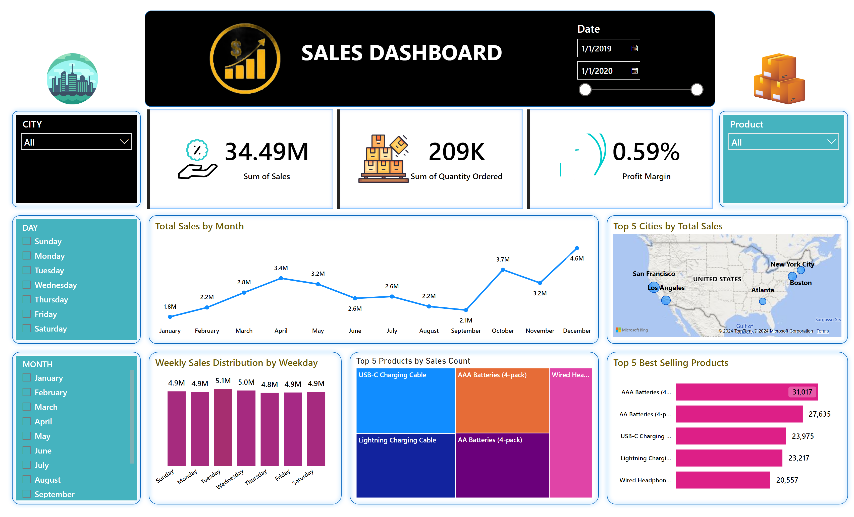
Home
Notes:
shape
No alt text provided
Total Sales by Month
No alt text provided
shape
No alt text provided
Top 5 Products by Sales Count
No alt text provided
shape
No alt text provided
Top 5 Best Selling Products
No alt text provided
shape
No alt text provided
Top 5 Cities by Total Sales
No alt text provided
shape
No alt text provided
Weekly Sales Distribution by Weekday
No alt text provided
shape
No alt text provided
slicer
No alt text provided
shape
No alt text provided
slicer
No alt text provided
cardVisual
No alt text provided
shape
No alt text provided
slicer
No alt text provided
shape
No alt text provided
slicer
No alt text provided
shape
No alt text provided
textbox
No alt text provided
image
No alt text provided
image
No alt text provided
slicer
No alt text provided
image
No alt text provided

